Slide 1
Community Site Something
노세현(sehyeonn)

Slide 2
Index
Purpose
Functions
Page Design
Database

Slide 3
Purpose
For practice basic JAVA Spring.
For practice basic HTML/CSS/JavaScript
Namely, for study.

Slide 4
Functions
CRUD the post
CRUD the category
Comment
Search

Slide 5
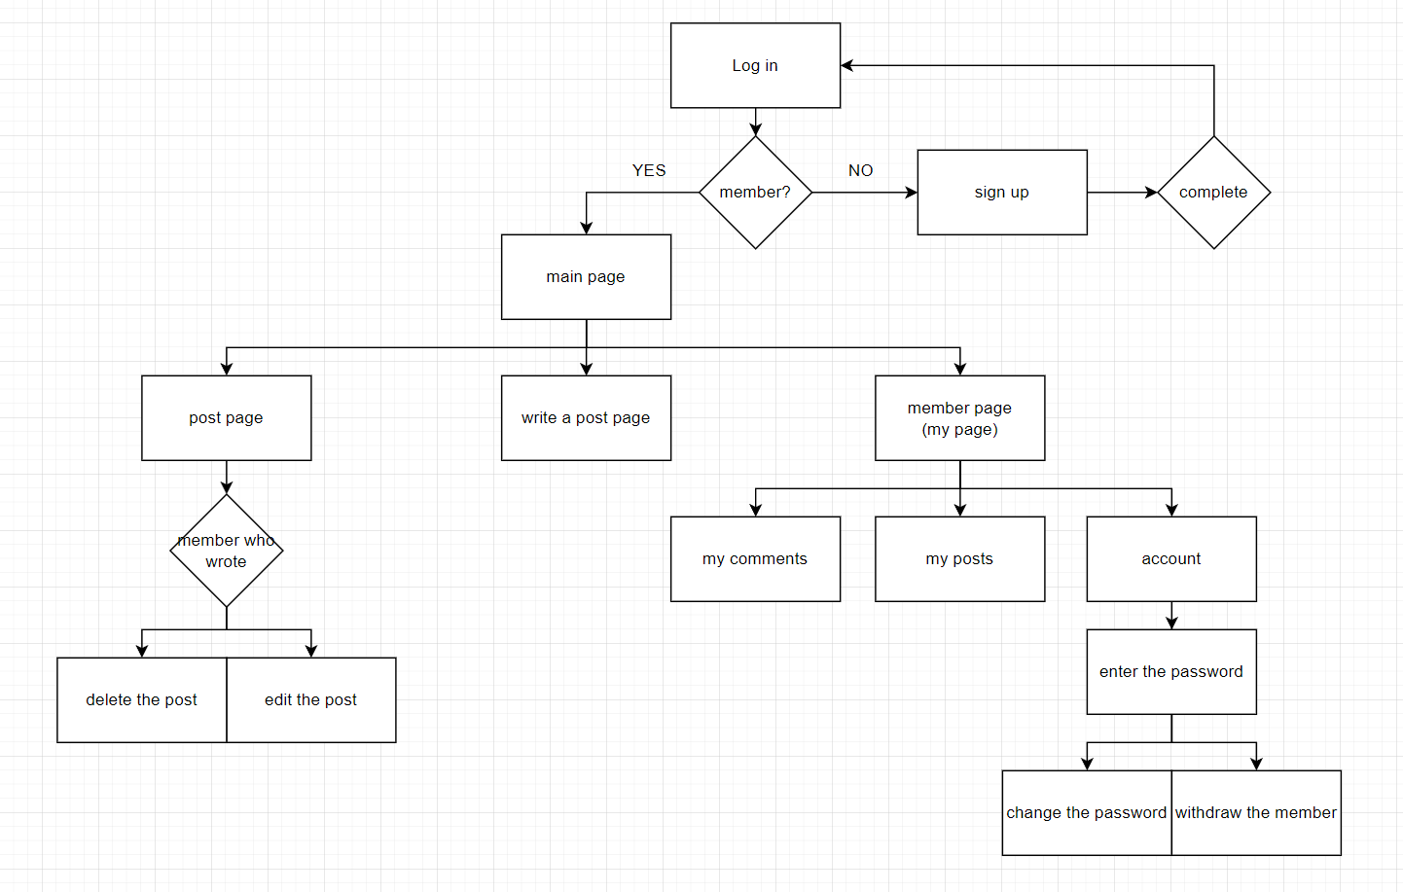
Common page design

Slide 6
Log in page
COMMUNITY SITE SOMETHING
E-mail
PASSWORD
Log in
Don’t have account? Sign up
Click and move to sign up page

Slide 7
Sign up page
Sign up
E-mail
USERNAME
PASSWORD
PASSWORD
Sign up
Click and move to log in page,
Add a new member to the DB

Slide 8
Main list page
COMUNITY SITE SOMTHING administration Username
Click and move to admin Page,
Appears only when logged in as the admin
Mouse hover and drop down the menu
category1 category2 category3
Posting
Mouse hover and drop down the menu
id | title | author | date | hits
4856783 | something [12] | someone | 2022-02-24 | 32
Click and move to the post page
The number of comments
Click and move to post page
<< | < | 1 | 2 | 3 | 4 | 5 | 6 | 7 | 8 | 9 | 10 | > | >>
Posting

Slide 9
Main list page
COMUNITY SITE SOMTHING administration Username
Users
management
My posts
category1 category2 category3
Statistics
My comments
Posting
id | title | author | date | hits
4856783 | something [12] | someone | 2022-02-24 | 32
<< | < | 1 | 2 | 3 | 4 | 5 | 6 | 7 | 8 | 9 | 10 | > | >>
Posting

Slide 10
Post page
COMUNITY SITE SOMTHING administration Username
Title
author | 2022-02-24 | comments 12 | hits 32
Something something content Hahaha
These two buttons only appear when logged in as the author
Delete button appears when logged in as the admin too
Edit
Delete
Comments
someone | 2022-02-24 13:30
Lol something Hahaha
someone2 | 2022-02-25 21:22
OMG Something good
Click and complete post a comment,
Add a new comment to the DB
Post a comment
Write your comment
Post

Slide 11
Posting page
COMUNITY SITE SOMTHING administration Username
Posting
Title
Click and move to main page,
Add a new post to the DB
Post

Slide 12
My posts page
COMUNITY SITE SOMTHING administration Username
My posts
id | title | date | hits
4856783 | something [12] | 2022-02-24 | 32
<< | < | 1 | 2 | 3 | 4 | 5 | 6 | 7 | 8 | 9 | 10 | > | >>

Slide 13
My comments page
COMUNITY SITE SOMTHING administration Username
My comments
id | title | comment | date
4856783 | something [12] | Hahaha | 2022-02-24 16:39
<< | < | 1 | 2 | 3 | 4 | 5 | 6 | 7 | 8 | 9 | 10 | > | >>

Slide 14
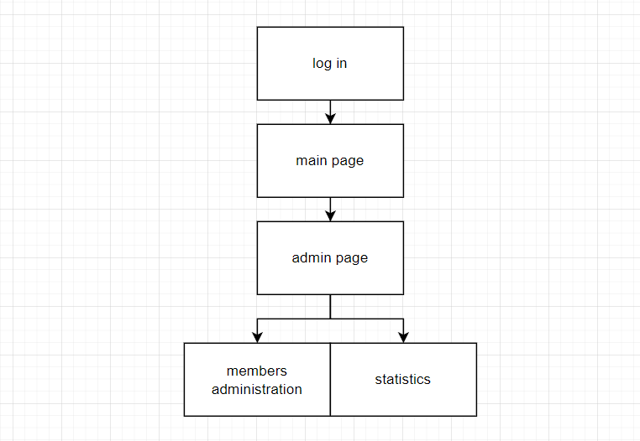
Admin page design

Slide 15
Admin page – Users management
COMUNITY SITE SOMTHING administration Username
Members management
 | username | Sign up date | Recent visit date | posts | comments
 | someone | 2022-12-23 | 2022-02-24 | 7 | 11
About the checked members…
Check boxes
<< | < | 1 | 2 | 3 | 4 | 5 | 6 | 7 | 8 | 9 | 10 | > | >>

Slide 16
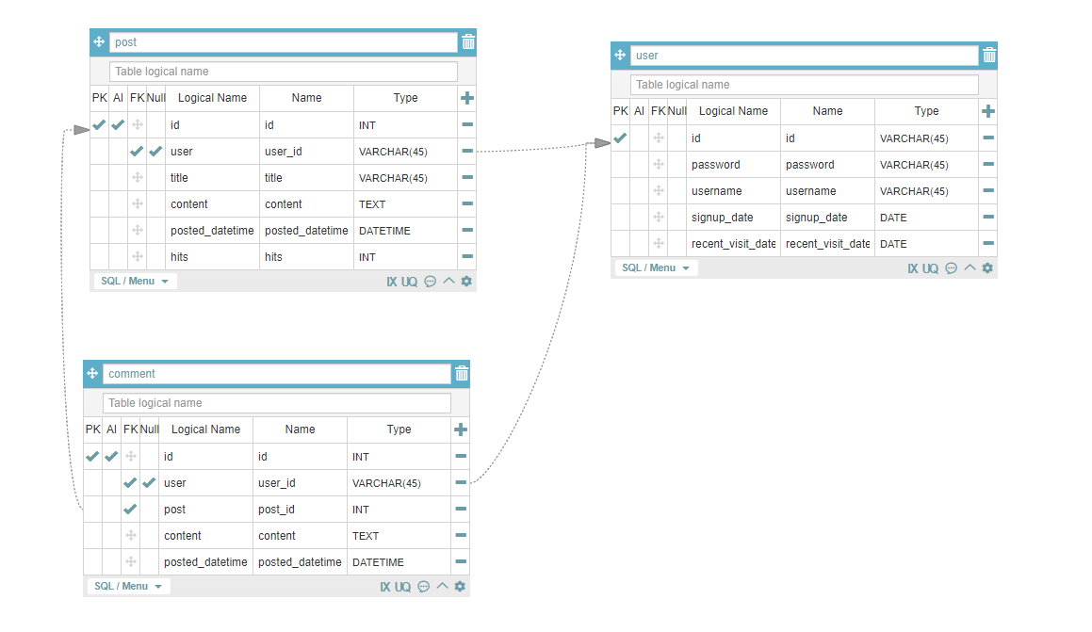
Database
Database user log in name : user_community_site
Password : communitysite0226

